Slide 1
Code Generation Session 25 - 26
Course : Comp6062 - Compilation Techniques
Effective Period : September 2018

Slide 2
Learning Outcomes
At the end of this meeting, expected student will be able to:
Students can show results from a case code Genarator program compilation (C3)
Students can make a diagram / schema compiler is the most optimal design (C4)

Slide 3
Content Outline
Issues in the design of code generator
The target machine
DAG representation of basic blocks
Register allocation and assignment

Slide 4
Posisi Code Generation
The last stage of the compiler is a code generator. Input code generator is the intermediate representation of source programs, and the output is the target of an equivalent program. Position code generator in the compiler are as follows:
source
program
front
end
intermediate
code
code
optimizer
intermediate
code
code
generator
target
program
symbol
table

Slide 5
Terms or Requirement code generator
output code should be correct and of high quality, which must use the resources of the target machine effectively. must be efficient.
Mathematically, the problem to generate optimal code that is undecidable. In practice, we will use the heuristic techniques are nice, but not necessarily optimal code.

Slide 6
Issues in the Code Generator Design
Although highly dependent on the target machine and operating system, issues that are important in code generation are:
Input to the code generator
Target program
Memory Management
Instruction Selection
Register Allocation
Order Selection Evaluation
Approach Code Generator

Slide 7
Input for Code Generator
Input to the code generator consists of an intermediate representation of source programs generated by the front-end, along with information in the symbol table that is used to determine the run time address of the data object indicated by the names of the intermediate representation.
It is assumed that prior to code generation, front-end has to scan, to parse, and translate the source program into an intermediate representative sentation detail.
In addition, assumed to have been done type checking, so that type-conver-sion operator has been inserted where necessary and semantic error has been detected.

Slide 8
Target Program
The output of code generator is the target program, which could take the form: Absolute Machine Language, Relocatable Machine Language, Assembly Language
Target programs in the form of Absolute machine language had a profit can be placed in a fixed location in memory and can be executed directly. Small program can be compiled and executed quickly.
Example: The number of "student-jobs' compiler, such as WATFIV and PL / C Profit target program in the form of Relocatable Machine Language Program (Object Module) is a sub-program can be compiled separately.

Slide 9
Target Program
One set of relocatable object modules can be linked together and loaded by the linking loader to be executed.
Though out the extra effort for linking & loading, but we have more flexibility because it can compile the subroutine separately.
Assembly Language program as a target program has the advantage of ease of code generation process. We can generate the symbolic instruction & use the macro facilities of the assembler to generate code. The cost is the stage of assembly after the code generation.

Slide 10
Memory Management
Mapping a name in the source program to the address of the data object in the run-time memory is done jointly by the front-end and code generator.
It is assumed that the name in three-address statement referring to the symbol-table entry for that name. Type in the declaration determines the width (number of storage) required for the declared name.
Register R0, R1, . . ., Rn-1
op source, destination
MOV (move source to destination)
ADD (add source to destination)
SUB (subtract source to destination)
Address mode
Instruction Cost

Slide 11
Instruction Selection
Uniformity and completeness of the instruction set is an important factor.
In addition, other important factors are speed and machine instruction idioms.
Example:
Each three-address statement in the form: x: = y + z where x, y, and z is allocated in a static, can be translated into a sequence code:
MOV y, R0 / * load y into register R0 * / ADD z, R0 / * add z to R0 * / MOV R0, x / * store R0 into x * /

Slide 12
Instruction Selection
But the statement-by-statement code generation often produces bad code. Example: The sequence of statements
a: = b + c d: = a + e
can be translated into: MOV b, R0 ADD c, R0 MOV R0, a MOV a, R0 ADD e, R0 MOV R0, d
Here the third and fourth statements would be redundant, as well as a third statement if a is not used in sequence.

Slide 13
Register Allocation
Instructions involving register operands are usually shorter and faster than those involving operands in memory.
Therefore, the efficient use of registers is very important to generate good code.
The use of registers is divided into 2 sub-problems:
During register allocation, selected variables that will be settled in the register at a point in the program.
During the register assignment, taken a special register where the variable will be settled.
Finding an optimal assignment of registers to variables is difficult, even with a single register. Mathematically, this problem is NP-Complete.

Slide 14
Order Selection Evaluation
The order did computing can affect the efficiency of target code. Several computational sequence requires fewer registers to hold intermediate result than the other. Taking the best order is NP-Complete Problem.

Slide 15
Approach Code Generator
The most important criteria for code generator is to produce good code.
One of the important design objectives of the Code Generator is:
easily implemented
easily tested
easy to maintain

Slide 16
Basic Blocks as DAGs
Like expressions, we can represent basic blocks as DAGs
Create a node for the initial value of each variable that appears in the block
For each statement s, create a node N whose children are the nodes defining the operands of s
Each node N is labelled by the operation used
Each node N has a list of variables that it defines
A node N is marked as an output node if its value is used outside the basic block

Slide 17
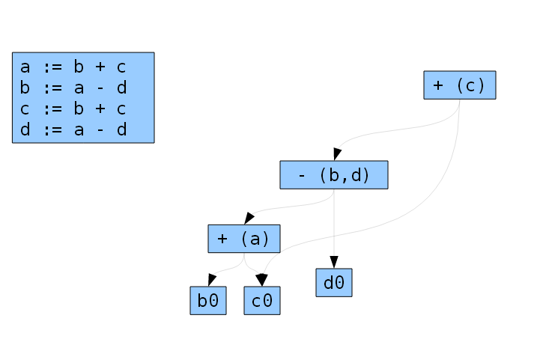
Basic Block Example

Slide 18
Run-Time Storage
Allocation strategies: Static and Stack
Static allocation In static allocation call statement is translated into:
Move #here + 20, callee.static_area
GOTO calle.code_area
Three-Address Code
/* code for c */
action₁
call p
action₂
halt
/* code for p */
action₃
return
Activation Record
for c (64 bytes)
0:return address
8:
arr
56:i
60:j
Activation Record
for p (88 bytes)
0:return address
4:
buf
84:n

Slide 19
References
Aho, A.V., Ravi, S., & Ullman, J.D. (2007). Compiler : Principle, techniques and tools. 2nd. Addison-Wesley. New York. ISBN : 0321491696, Chapter 8.5 – 8.11 (page 533-575)
http://bears.ece.ucsb.edu/class/ece253/compiler_opt/c2.pdf
http://cg.scs.carleton.ca/~morin/teaching/3002/notes/various.pdf

